Slide 1
FATIGUE OF MATERIALS & STRUCTURES
G. Hénaff
1

Slide 2
Outline
Introduction
Cyclic deformation & Low-Cycle Fatigue
High-Cycle Fatigue
Fatigue from Notches
Fatigue Crack Propagation

Slide 3
INTRODUCTION TO FATIGUE

Slide 4
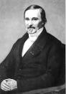
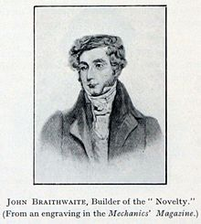
Definition
« Progressive damage process developping as cracks under reversed loads, even of very small amplitude, without any concomitant change in the macroscopic behaviour but leading to failure »
The origin of the wording « Fatigue » is controversial: Jean-Victor Poncelet, in 1839, described metals as “fatigued” after many load reversals. The word “fatigue” would have been first introduced by John Braithwaite in 1854 but he attributed the paternity to an unknown Mr Field.

Slide 5
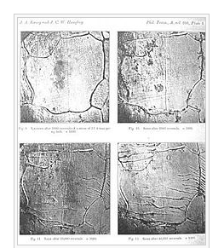
Timeline of early research history
1837: Wilhem Albert publishes the first paper on fatigue. He devised a test machine for conveyor chains in the Claustahl Mines.
1839: Jean-Victor Poncelet describes metals as being tired in his lectures in military school in Metz.
1842: William John Macquorn Rankine recognises the importance of stress concentrators in his investigation of railroad axle failures. The Versailles train crash is caused by axle fatigue.
1854: Braithwaite reports on common service fatigue failure and coins the term fatigue.
1870: August Wohler summarises his work on railroad axles. He concludes that cyclic stress range is more important than peak stress and introduces the concept of endurance limit.
1903: Sir James Alfred Ewing demonstrates the origin of fatigue failure as microscopic cracks

Slide 6
Timeline of early research history
1910: O. H. Basquin proposes a log-log relationship for S-N curves using Wohler’s data.
1945: A. M. Miner popularises A. Palgrem’s linear damage rule (1924) as a practical design tool.
1954: L. F. Coffin and S. S. Manson explain fatigue crack growth in terms of cyclic plastic strain at the crack tip. A series of crash occurs on teh Comet I civil transport aircraft.
1961: P. C. Paris proposes methods for predicting the fatigue crack growth rate in the face of initila septicism and popular defence of Miner’s rule.
1968: Tatsuo Endo and M. Matsuishi devise the rainflow counting algorithm and enable the reliable application of Miner’s rule to random loading
1970: W. Elber elucidates the mechanisms and importance of crack closure in slowing the growth of a fatigue crack due to the wedging effect of the plastic wake left behind the crack tip.

Slide 7
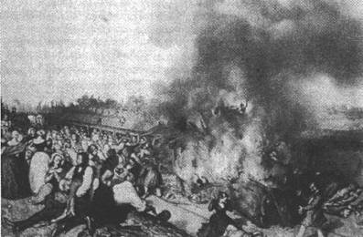
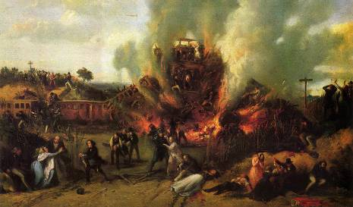
The crash of the Versailles train
The Meudon railway disaster is the first railway disaster in France and one of the first in the world. On May 8, 1842, a train from Versailles to Paris derailed in the Bellevue trench at Meudon. This derailment is followed by an overlap of leading cars followed by a fire. The accident caused 55 deaths including the sailor and explorer Jules Dumont d'Urville and his family.

Slide 8
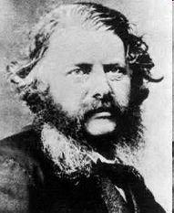
Historic Timeline
In the early 1840s, Scottish engineer William Rankine (1820-1872) began to examine broken axle fracture surfaces and showed that the mode of rupture was not related to any “Brittleness” of the material used, but to a mode of failure now known as fatigue mode. At that time, there was indeed a lot of confusion about the problem. His theory will be contested for several years by advocates of an opposite and erroneous theory around the myth, somehow strange, of a hypothetical "re-crystallization", weakening the material when applying a field of constraint.

Slide 9
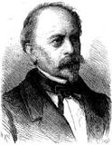
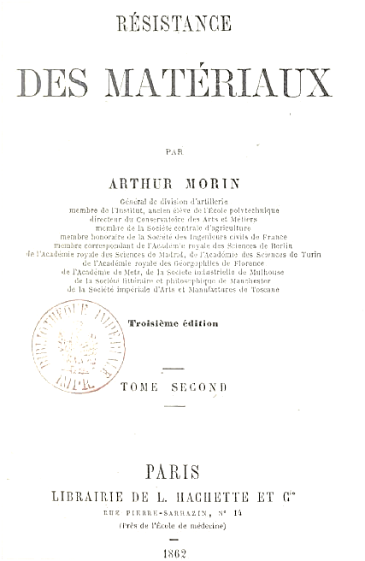
Historic Timeline
Given the severity of accidents due to failures in service (for example, the Paris-Versailles train in the 1840s), the author asks "if it would not be prudent to prescribe a limit in the distance traveled, beyond which all the axles of the railway equipment should be repaired or visited carefully. "
The author asks this question to two engineers, Mr. Marcoux, director of the material of the service of the mail coaches, and Mr. Arnoux, administrator of the general messengers. Mr Marcoux, on axles used in prolonged service, does not recognize "any appreciable change in the texture of the grain with what it was at the time of manufacture of the axles. "
Does Mr. Marcoux deny the fatigue of the axles? No !
The latter "thinks, on the contrary, that the vibrations which the axles experience in the high-speed steps deteriorate the iron, without however the grain texture experiences any appreciable change", and that "the axles are less resistant after a long period Service ". Accordingly, the latter "prescribes, in the specifications of the maintenance of the coaches, that the axles of these coaches will be renewed after having provided a course of 60 thousand kilometers".
Arthur Morin
1862

Slide 10
Historic Timeline
Mr. Marcoux then remarks that "well-made axles, with good quality irons, fail after having provided a course of 60 to 80 thousand kilometers, because small cracks are formed below the flange of the spindles, It is difficult to recognize without heating the iron of the spindles: if these cracks, which have a small depth when they are formed, remain undetected, the axles fail at this point when they penetrate from 10 to 15 millimeters in the section of the spindle. ".
He then gives his explanation of the phenomenon: "I think that these cracks are formed after a long use, that they are occasioned by the vibrations of the axles, and that this effect occurs in a manner analogous to what happens when one breaks a wire by bending it several times in opposite directions. If a wire is subjected only to very slight inflections over a great length, it cannot be broken: it is the effect which vibrations must produce on the body of the axle. But if the wire is tightened in a vice and subjected to several inflections in opposite directions, the iron extends on one side, discharges from the other, and the wire breaks close to the vice, as the axles break at the flange of the spindles. "

Slide 11
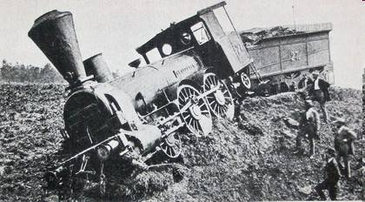
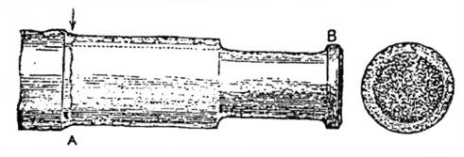
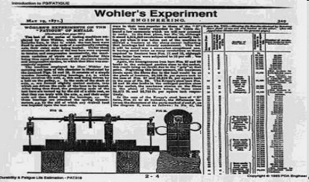
Historic Timeline
On October 19, 1875, the Amstetten locomotive serving the line Salzburg-Linz derailed: the cause of the accident was the fatigue ruin of a running gear. It was unknown at that time that the cyclic failure load of a material is less than its static failure load: it was up to August Wöhler to bring this fact to light.

Slide 12
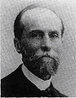
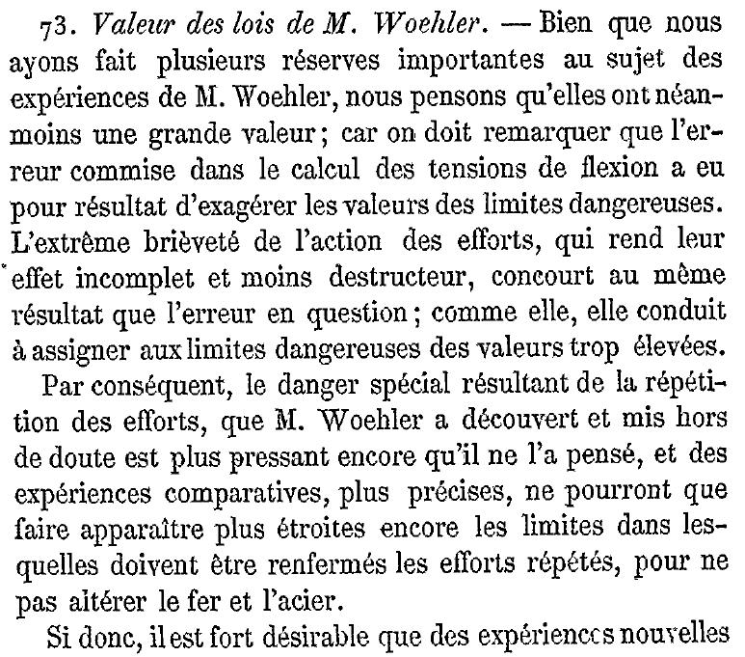
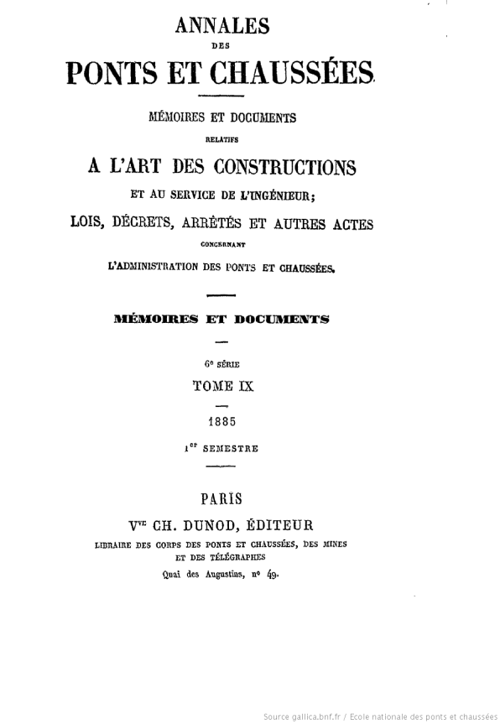
Historic Timeline
Armand Considère in « Annales des Ponts et Chaussées 1885 Semestre 1 ».

Slide 13


Historic Timeline : « No Highway»

Slide 14
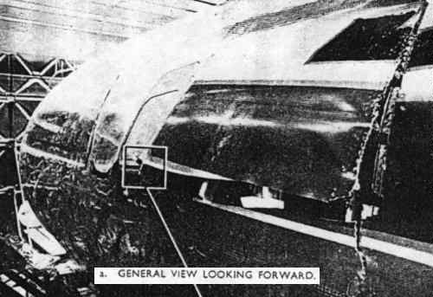
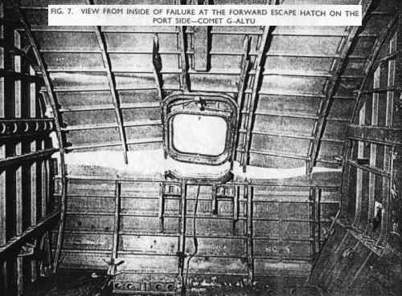
Comet crashes
1954 : series of crashes on Comet I aircrafts de crash sur les appareils Comet I.
2 cases → failure due to metal fatigue

Slide 15

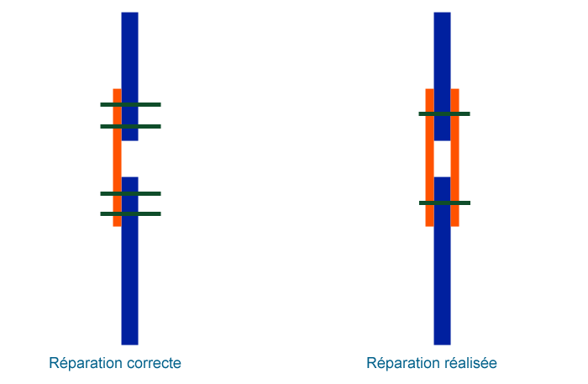
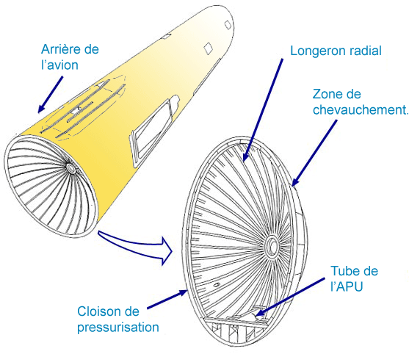
Japan Airlines 123, Boeing 747 (520 fatalities, 4 wound persons)
Incident (Tailstrike) in 1978: the rear pressure bulkhead was damaged .
Repair by Boeing : a technician used two plates instead of one but the assembly was idfficult to fix, so he decided to use only 1 rivet line instead of two.
This poor repair holds for many years, but quite a long time before the crash it gives signs of weakness characterised by a whistling at the rear of the aircraft during the flight. The crack is however too small at this stage to hamper the pressurization of the main cabin.
The fateful day, when the plane arrived at 24'000 feet, a typical altitude for decompression accidents, the pressure bulkhead tears explosively. The cabin air is propelled inside the tail unit and pulls out the rudder, the vertical stabilizer, half of the elevator and its stabilizer as well as the APU.
The JAL is pointed at the finger and in the press spread the shortcomings and errors that led to the drama. Several senior officials commit suicide. The technician who made the famous repair will also end his days.

Slide 16
Japan Airlines 123, Boeing 747 (520 fatalities, 4 wound persons)

Slide 17
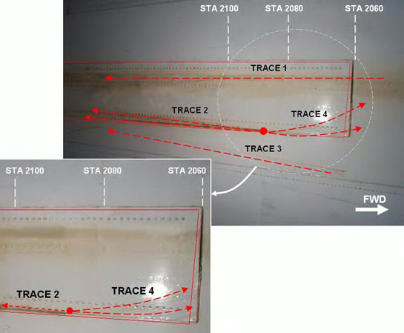
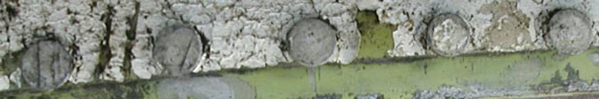
China Airlines 611, 2002 (225 fatalities)
The investigation showed that the accident was caused by the fatigue of the structure of the aircraft, combined with a poor repair after an incident (Tailstrike): on February 7, 1980, the aircraft tail had hit the runway on landing in Hong Kong.
This repair was not made according to the SRM (Structural Maintenance Manual) requirements: the damaged part of the aircraft (section 46) was not removed and the reinforcement affixed was not wide enough to cover the entire damaged area.
During the many subsequent flights (depressurization and pressurization cycles), the badly repaired part gradually cracked. It finally failed 22 years later, during a flight. The decompression that followed completely disintegrated the aircraft.
Nicotine stains are tell-tail signs of fatigue crack growth in pressure hull skin
2.3m crack growth in 20,000 flights

Slide 18
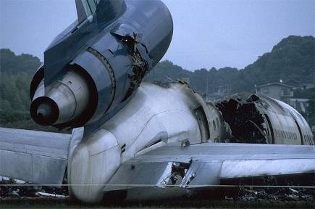
United Airlines 232 , Sioux City, DC-10, 1989

Slide 19
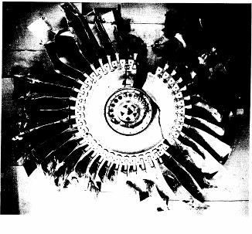
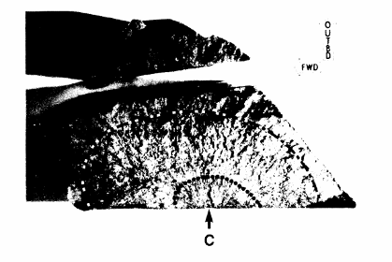
United Airlines 232 , Sioux City, DC-10
“Fatigue crack fracture area cut from the bore of the smaller piece of the separated stage 1 fan disk.cavity (arrowThe fatigue crack extends from the"C") to the dashed line position. The discolored portion ofthe fatigue crack is between the cavity and the dotted line. Magnification:2.26X.”
“Some areas of fatigue striations were found just outboard of the stabilized-alpha portion of the inclusion at the fatigue origin. However, between the cavity bottom and a radial distance of 0.025 inch outboard of the bore surface, areas with brittle fracture features and a lack of fatigue striations were found intermixed among more ductile-appearing bands with fatigue striations.
The zone with a mixture of brittle features and fatigue striation areas correlated with the enriched alpha microstructure surrounding the stabilized-alpha core of the inclusion.
The fatigue striation spacing generally increased as distance from the origin area increased. However, starting at a distance of about 0.145 inch outboard of the bore surface, areas with much more closely spaced striations were also found. The more closely spaced striations were referred to as minor striations, and the striations with wider spacings were referred to as major striations.”

Slide 20
American Airlines N330AA, LAX (June, 2nd 2006)

Slide 21
American Airlines N330AA, LAX (June, 2nd 2006)

Slide 22
American Airlines N330AA, LAX (June, 2nd 2006)

Slide 23
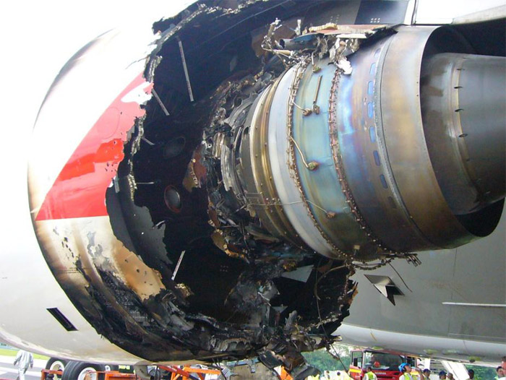
Qantas QF 32, 2010 (0 victim)
Off Singapore, Nov 2010, 21
2 year old A380 superjumbo, Trent 900 engine
Main cause: “defect of manufacture of high pressure and intermediate pressure turbines, where the circuit distributes the oil for the bearings of the shafts"
Repairs 139 million Australian dollars (All four engines have been replaced, the wing has been repaired and six kilometers of wiring have been changed, overweight: 94 kg)

Slide 24
Qantas QF 32, 2010 (0 victim)

Slide 25
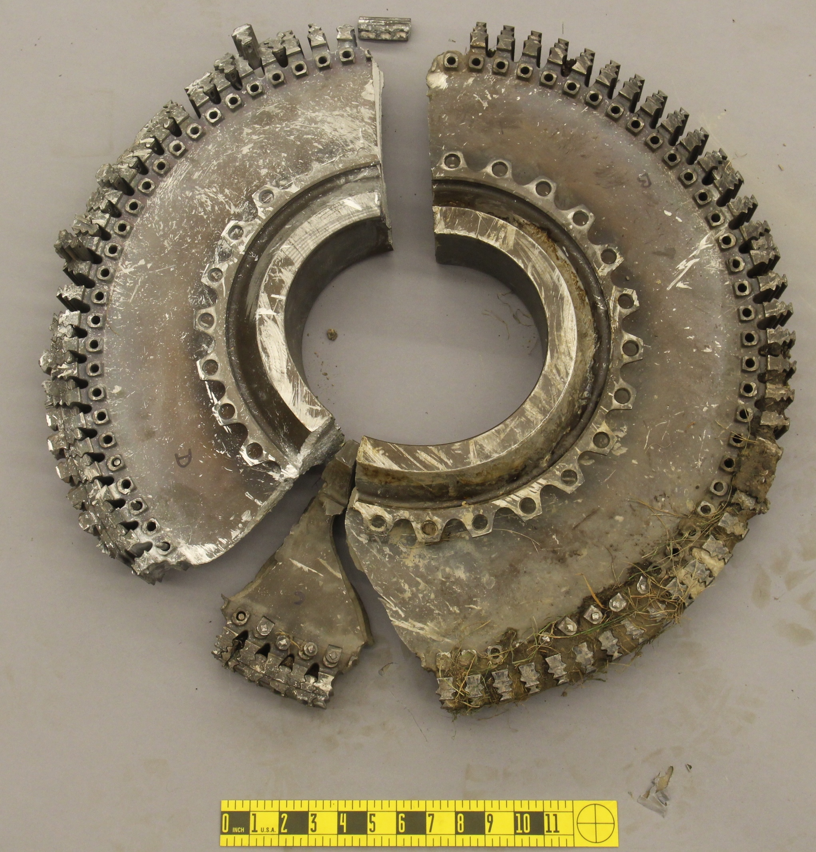
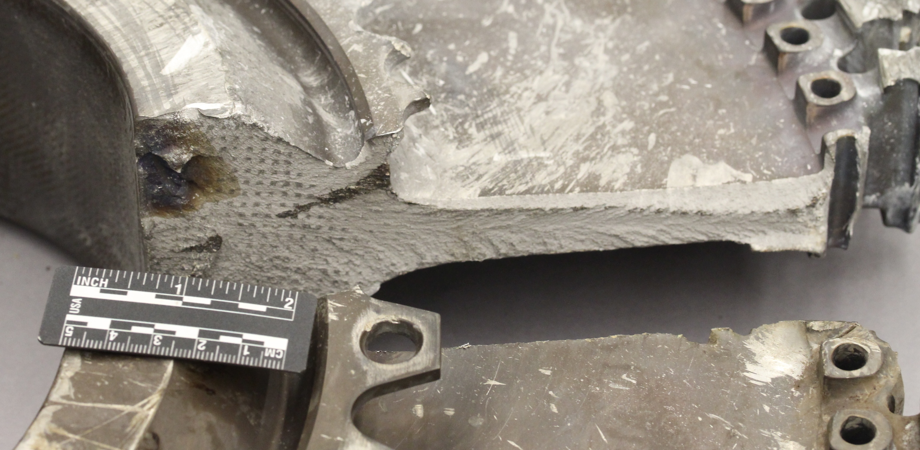
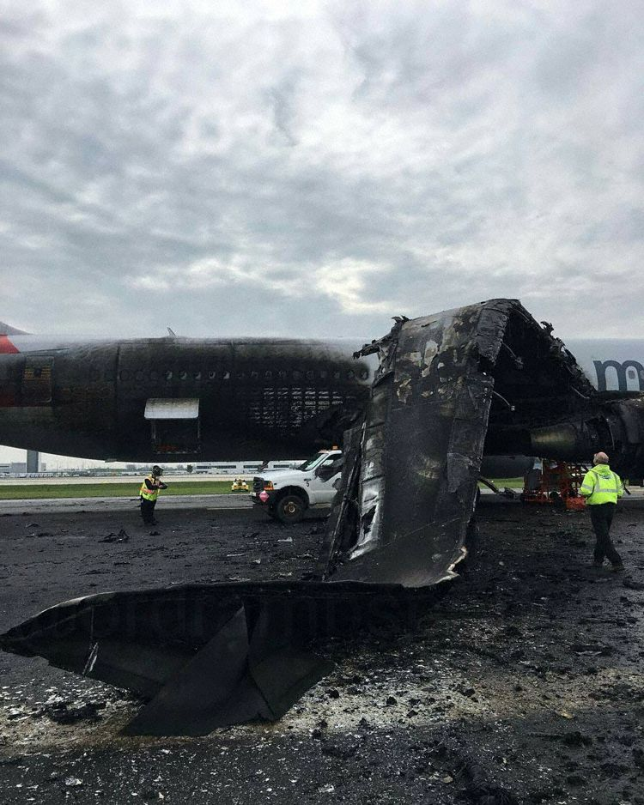
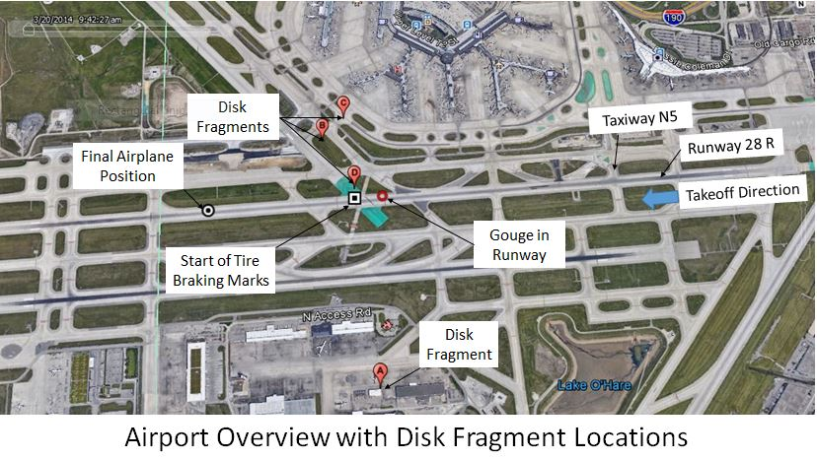
Uncontained failure of a GE CF6-80C2B6 engine occurred on a Boeing 767-300 (Oct. 28, 2016)
Fatigue crack location on a disk fracture surface
Recovered stage 2 HPT disk pieces
10,984 cycles / life limit of 15,000 cycles
http://www.ntsb.gov/news/press-releases/Pages/pr20161104.aspx

Slide 26
ICE Eschede 1998

Slide 27
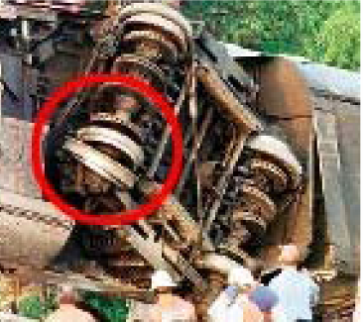
ICE Eschede 1998

Slide 28
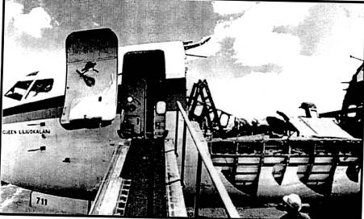
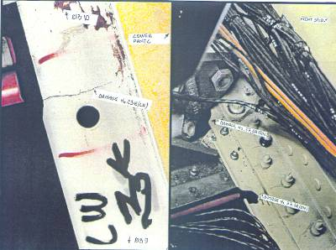
Fatigue : still an issue
Today: less disasters;
Nevertheless, this problem is always present and must always be taken into account in the design and maintenance of structures (transport, energy production, mechanical industry, etc.) and in the development of new alloys.
Boeing 737 - 1988: fuselage failure
Longerons ATR : présence de fissures de fatigue

Slide 29
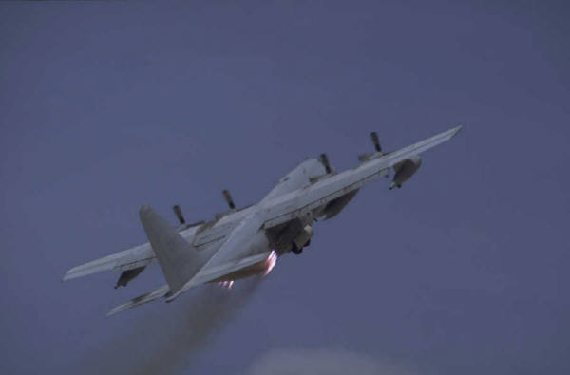
Fatigue in practice
80% of failures in service are due to the fatigue phenomenon (1982 estimated cost of about 4% of GDP in the USA);
Among these failures, about 80% are due to a poor understanding of this phenomenon in the design (bad design, inadequate criterion, ...)

Slide 30
Fatigue in practice
Fatigue affects many fields of activity. Examples:
Automotive
Agricultural machineries
Aéircrafts
Pressure vessels
Pipings
Implants (valves, prostheses, ...)
Microelectronics
….

Slide 31
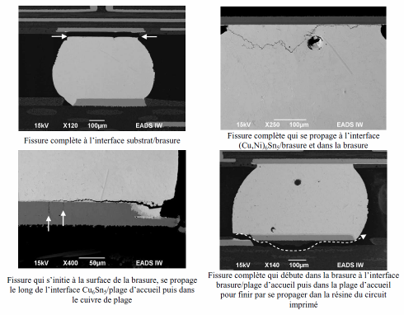
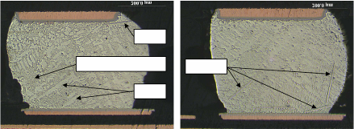
Microelectonics

Slide 32
Examples of Fatigue Failure

Slide 33
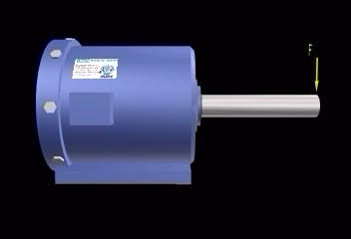
Fatigue Damage
σ
σ_{Α}
σ_{max}
t
σ_{min}
Τ=1/f

Slide 34

Morphology of a Fatigue Fracture Surface

Slide 35
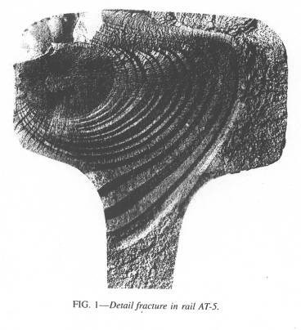
Morphology of a Fatigue Fracture Surface
Shear lips
B
R
Initiation site
A
Propagation with different growth rates
Final failure

Slide 36
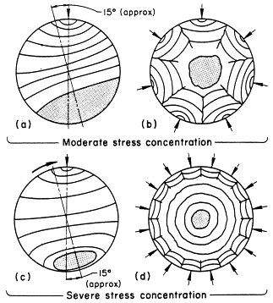
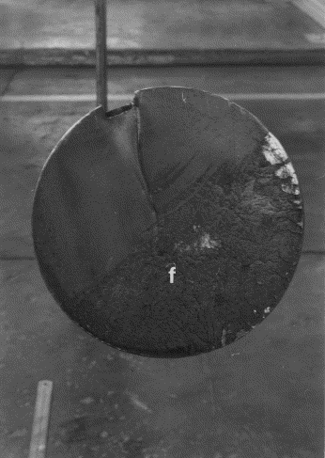
Pump shaft failure
Morphologie des Ruptures

Slide 37
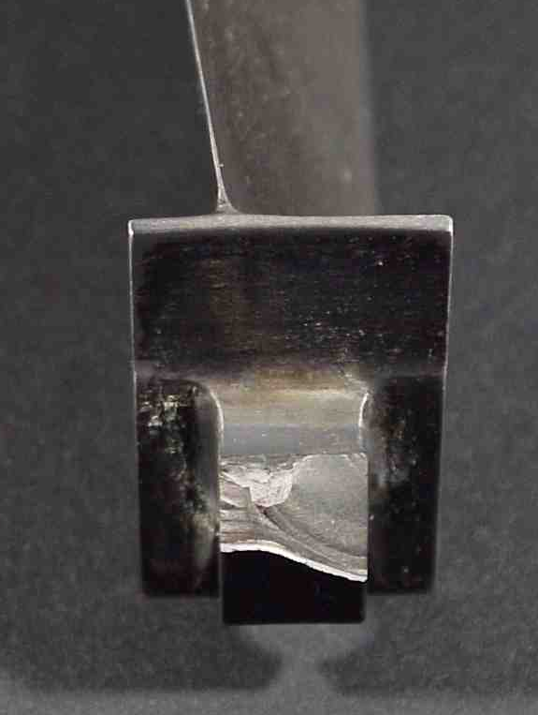
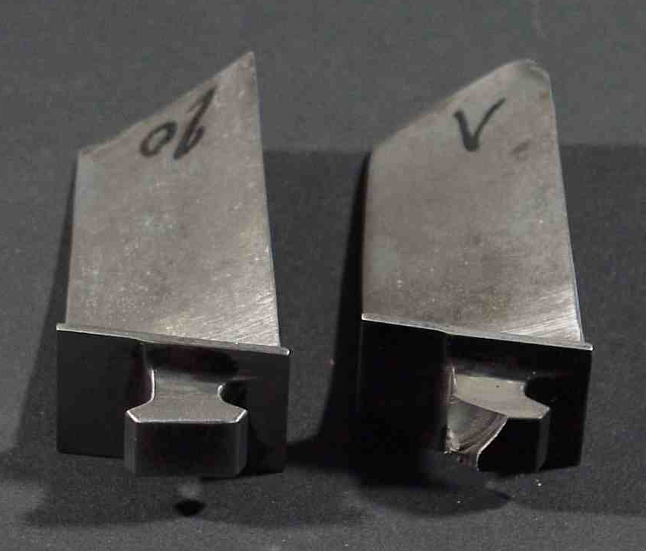
Failure of a titanium alloy turbine blade

Slide 38
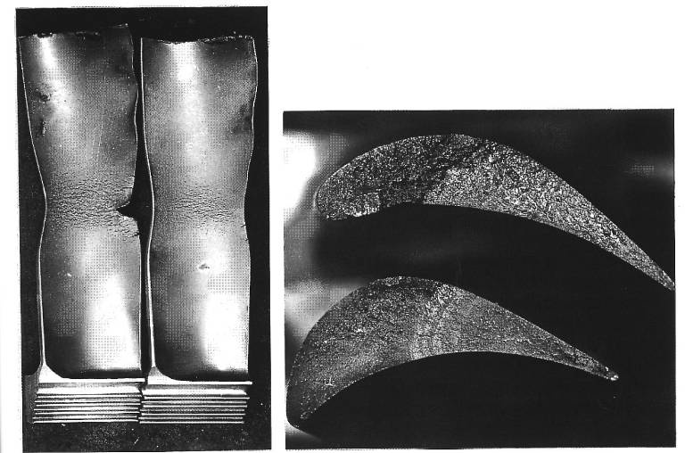
High temperature failure blade
Creep-fatigue cracking
Propagation

Slide 39
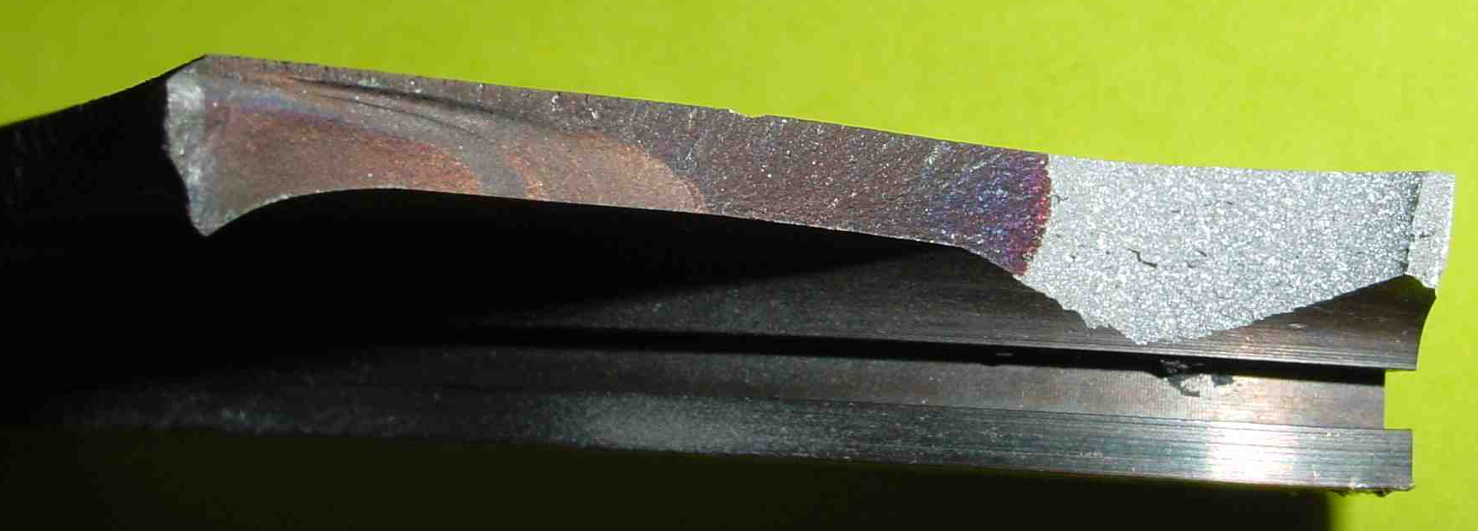
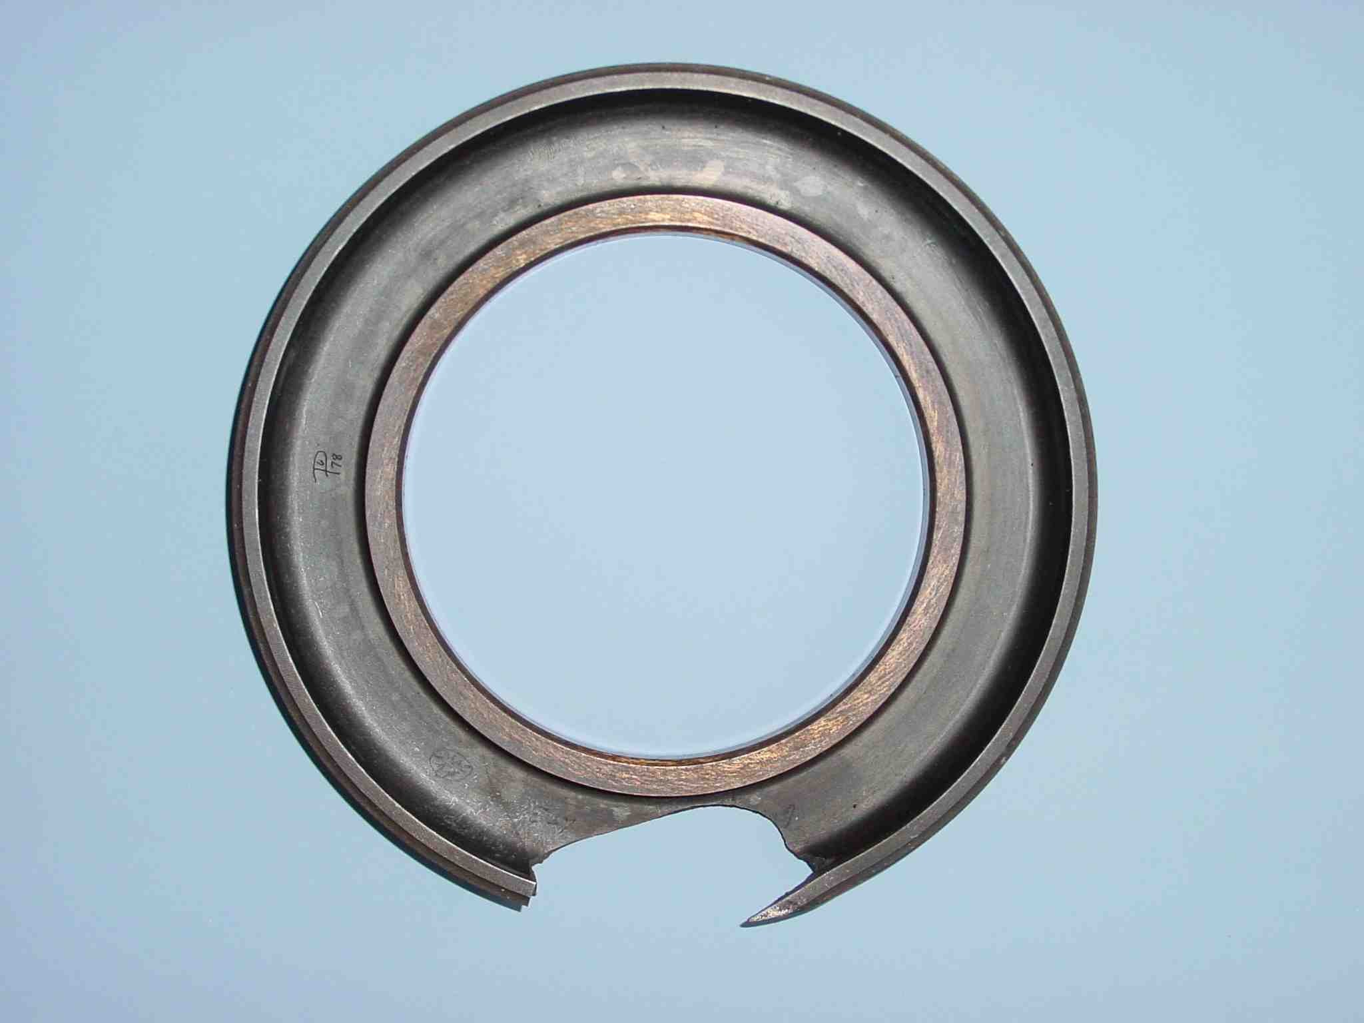
Failure of a land turbine
Secondary cracking
Cracked part

Slide 40
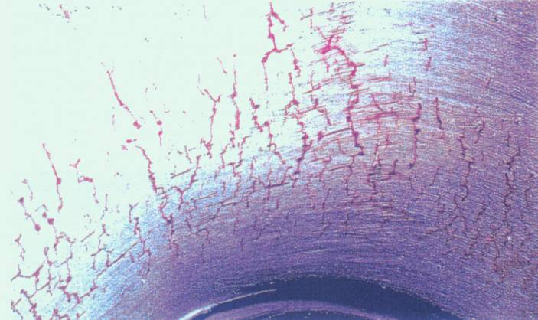
Thermal fatigue
Faïençage thermique dans un coude de tuyauterie

Slide 41
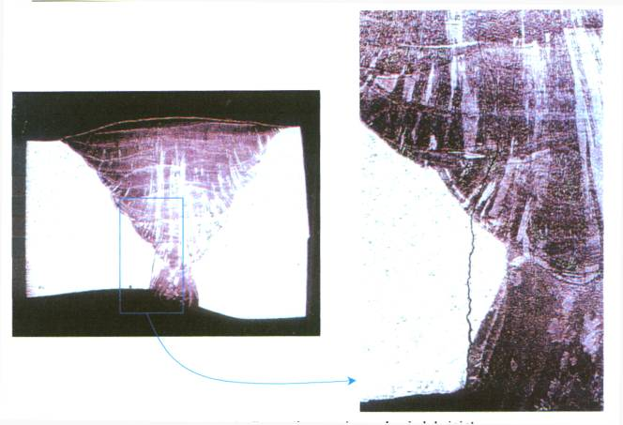
Thermal Fatigue: Failure at a weld joint

Slide 42
Fatigue Mechanisms

Slide 43
Fatigue Failure
3 stages:
- Initiation of one of several microcracks
- Propagation of a main crack
- Final failure
Fatigue Life

Slide 44

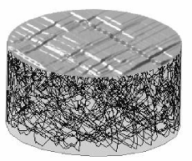
Cyclic Deformation and Initiation

Slide 45
AFM observation of extrusions

Slide 46
Surface deformation
Intrusion/extrusion at the surface of a fatigued copper single crystal

Slide 47
Crack initiation sites
(iii)
(iv)
(i)
(vi)
(v)
(ii)
(i) Transgranular (persistent slip band)
Surface
(ii) Intergranlular (along a grain boundary)
(iii) On a defect (porosity, shrinkage, inclusion)
(iv) On a defect (porosity, shrinkage, inclusion)
Internal
(v) Along a grain boundary
(vi) On a triple junction

Slide 48
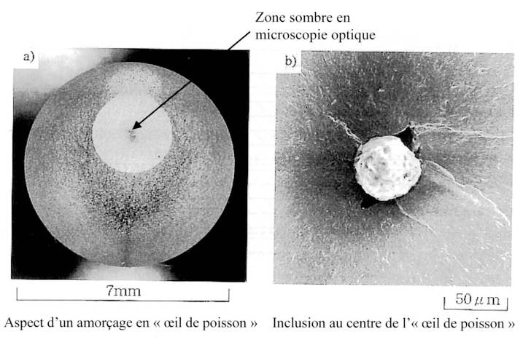
Example of internal initiation: « Fish-eye » failure

Slide 49
Propagation stages
Stage I
Stage II
Stage I : crystallographic cracking mode
Stage II : propagation macroscopically perpendicular to the mode I loading axis

Slide 50
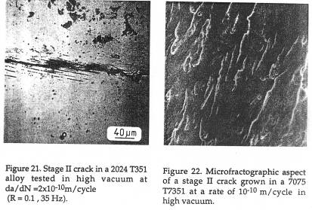
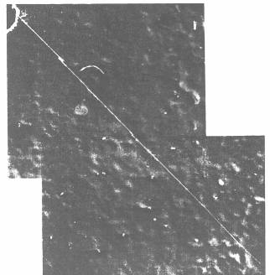
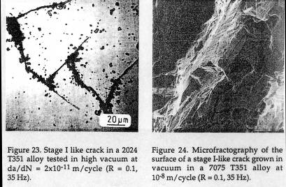
Propagation stages
Stage II
Stage I propagation in an Aluminium single crystal

Slide 51
Design Methodologies

Slide 52
Industrial approach
Need to have both an experimental approach and a "calculation" approach
The closer the calculation and the experimentation to the real service conditions, the higher the level of confidence in the results
Different approaches exist, more or less costly and / or complex;
It is necessary to properly evaluate the cost over the operating life of the structure;

Slide 53
Industrial approach
Safety factors are commonly used. A too high value leads to an over conservatism, therefore to a non-competitive product; Too low a value may lead to failures before the end of the lifetime.
The use of safety factors does not exonerate from a suitable design approach.

Slide 54

Different approaches to predict fatigue life of a component
Stress concentration area ⇔ low-cycle fatigue micro-sample ⇒ number of cycles to initiation N_{a}
Initiation site
Initiation
propagation
Fatigue crack growth data (LEFM) ⇒ number of propagation cycles N_{p}
General case: N_{f}= N_{a}+ N_{p}
In practice:
N_{a}» N_{p} or N_{a}« N_{p}
σ
t

Slide 55
Design Philosophies
Safe Life (« Durée de vie sûre »).
Fail safe (Multiple load paths; crack arresters).
Damage tolerance (controlled propagation of an initial crack-like flaw)

Slide 56

Certification A380
Accelerated test simulating 47 500 flights, i. e. 25 years of commercial service, in 26 months
184 computer-controlled hydraulic rods

Slide 57



Certification A380

Slide 58

Design criteria for the A380 fuselage

Slide 59

Design criteria for the A380 wing

